Slide 1
Superstore Data Analysis
Presented by:
Jay Kumar Rajput

Slide 2
Data Set
Attributes:
Shipmode- First class, same day, second class, standard class.
Sales- sales amount.
Quantity- amount of product sold.
Discount- discount provided on product.
Profit- profit amount generated from product.
Segment- consumer, corporate, home office.
Region- central, east, south, west.
State- name of state.
Category- furniture, office supplies, technology.
Subcategory- different subcategory divided among each category.
orderdate_day
orderdate_weekday
orderdate_month
orderdate_year
shipdate_day
shipdate_weekday
shipdate_month
shipdate_year
Preparationtime
Source: Kaggle.com

Slide 3
Analytical Problems
Show discount, profit & sales on a map, which state has highest value?
Amongst different regions show discount, profit & sales data. Which region has lowest value?
Show the trend in discount, profit & sales with order time.
Show categories and sub categories along discount, profit & sales.
Which shipment mode do customers prefer? Show along side shipping time.

Slide 4
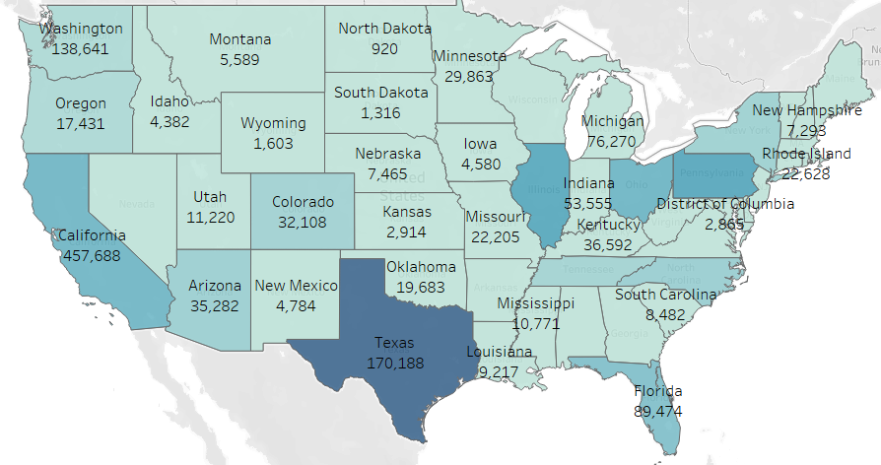
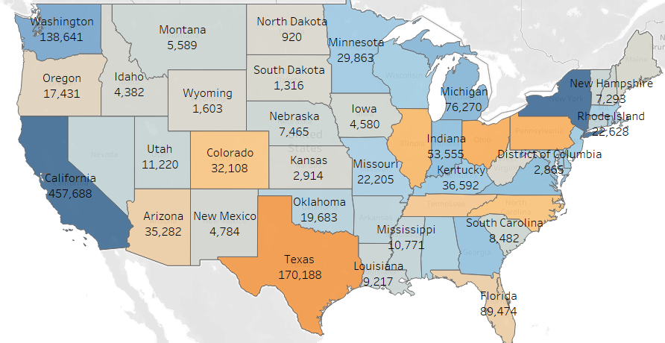
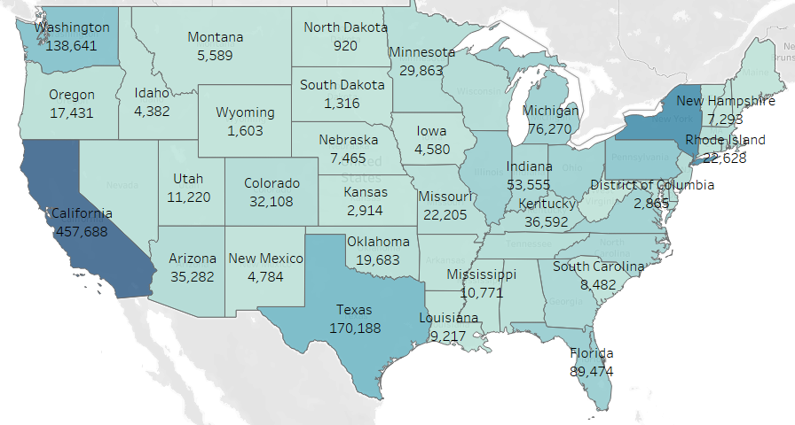
Problem analysis
Profit – California has highest profit
Discount – Texas provided highest discount
Sales – California has highest sales.

Slide 5
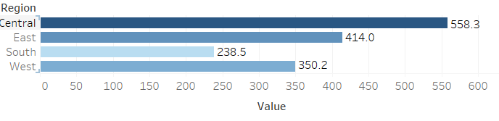
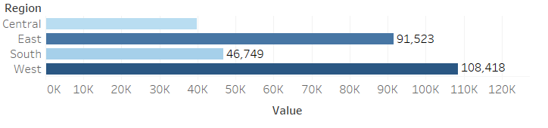
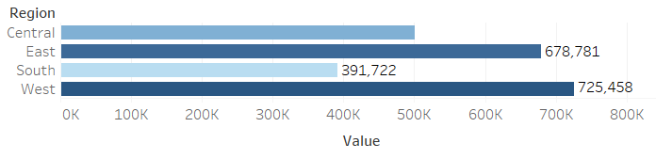
2. Discount- South region have given lowest discount.
Profit – Central region have lowest profit.
Sales – South region have lowest sales.

Slide 6
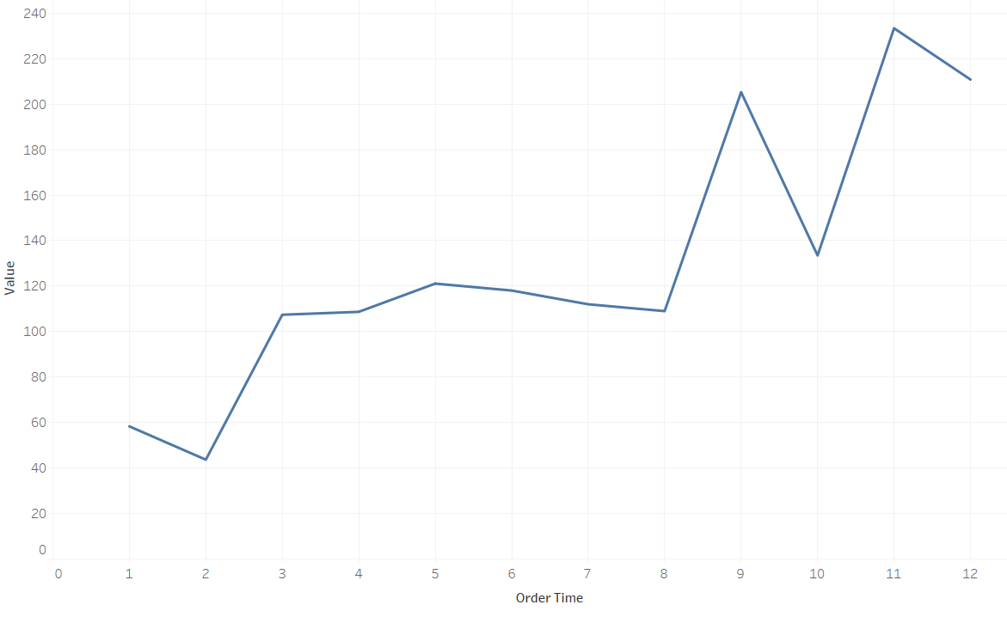
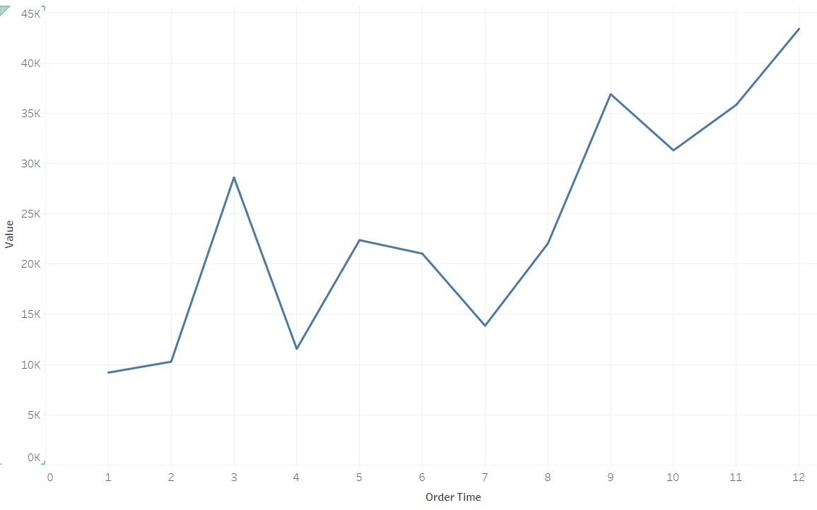
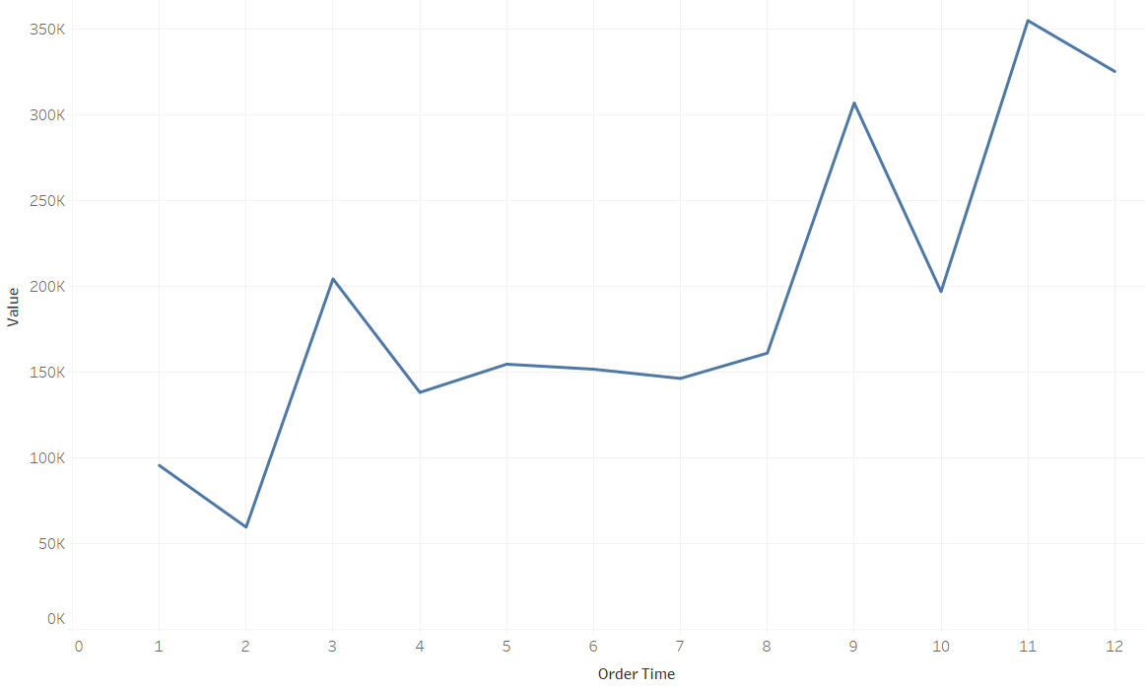
Order month vs Profit
3. Order month vs Discount
Ordre month vs Sales

Slide 7
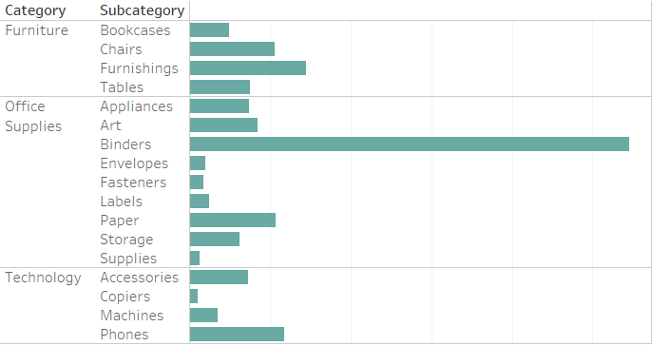
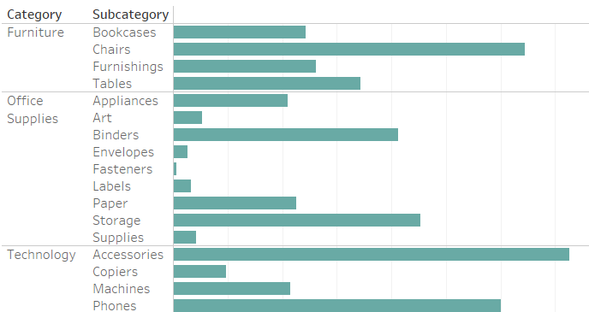
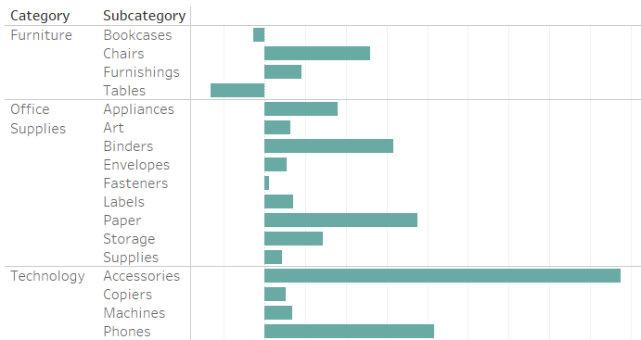
4. Discount Sales
Profit

Slide 8
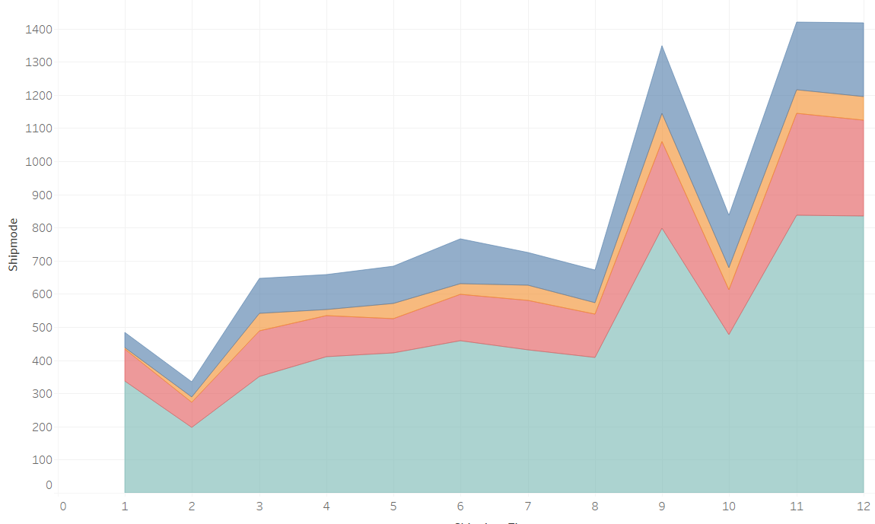
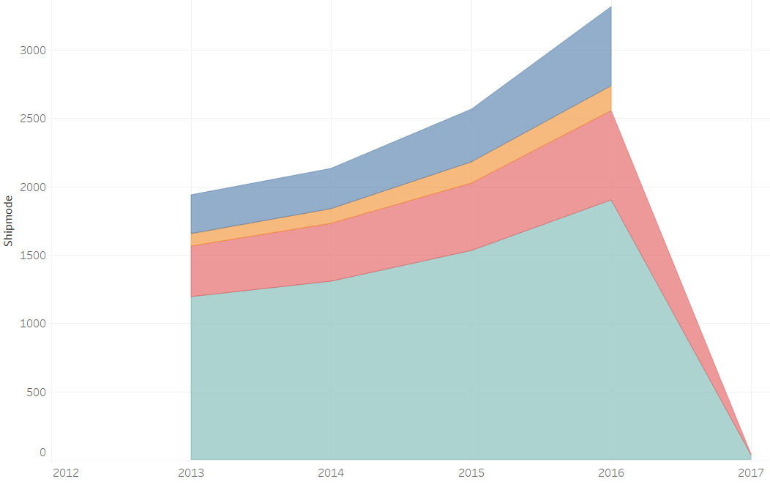
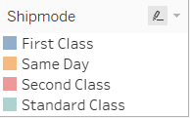
5. Shipping month vs shipping mode
Shipping year vs shipping mode

Slide 9
Conclusion:
Texas has given highest discounts, California has given the highest profit and sales also.
South region have given lowest discount, Central region have earned lowest profit and South region have lowest sales.
Based on order date more discounts are offered in last 4 months, so the profit and sales are high in these months.
Highest discount is given on Binders(office category), accessories of technology, chairs and phones have high sales, accessories have given the highest profit.
Mostly people prefer standard class shipmode and least prefer same day.
Useful link: link to drive.

Slide 10


